Slide 1

ECE 530 Cloud Computing
Ioannis Papapanagiotou
Introduction to Containers

Slide 2
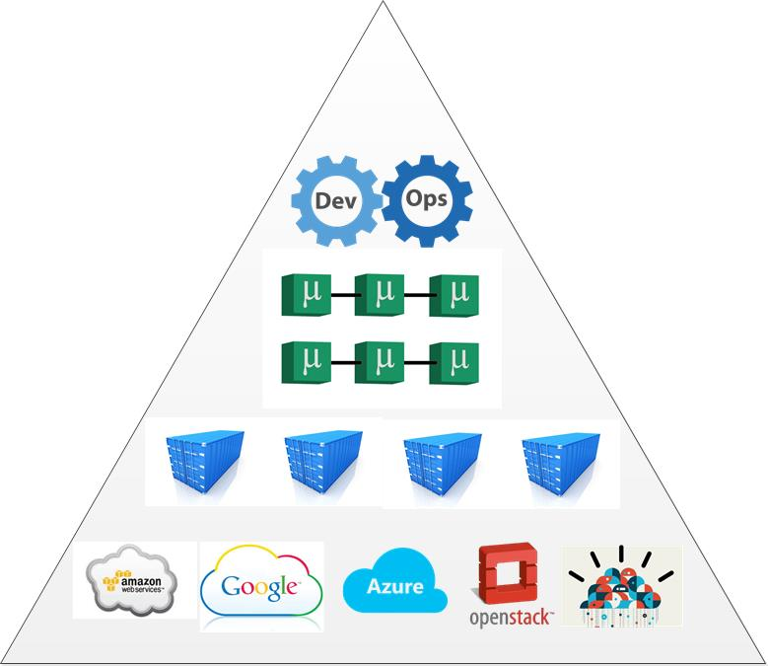
From microservices to containers
Agile software development is a broadly adopted methodology in enterprises today.
"full-stack-responsibility" for the individual services.
infrastructures need to scale differently and the self-service model for projects is taking center stage.
Containers are the foundation for this.
Along with proper DevOps and orchestration.
Notes:
there is very little room for departmental games and extended, official production ready procedures.

Slide 3
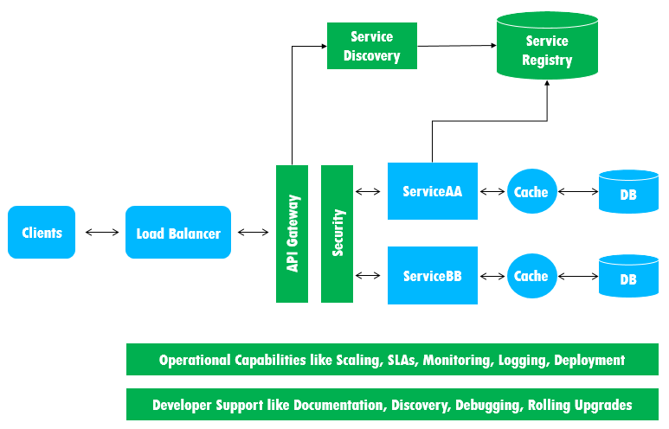
Microservices: Complexities and design considerations
Distributed application logic: with microservices the logic is spread across the services and, more importantly, embedded in the control and data flow between those services.
Diverse technology stack: the system may be comprised of in house developed services, open source software, and external libraries.
Hard to test and debug: there might be thousands of interactions between the constituent services
Equivalent to the “butterfly effect” (a minor change of service, could potentially be catastrophic)
Notes:
Distributed application logic: Unlike in case of a monolithic where the overall application logic is collocated, with microservices the logic is spread across the services and, more importantly, embedded in the control and data flow between those services. While the services each does its own thing — receive a request, apply logic, and produce a response — the functionality of the application is realized only by calling the right services at the right time, in the right sequence and with the right data. Furthermore, the same service could serve multiple different applications. Therefore, it is no longer possible to monitor, manage and secure an application based only on telemetry data collected at each service level.
Diverse technology stack: Real world applications are composed of many different services — for example, Amazon uses between 100 and 150 services to build a single page, while Google calls about 70 services for a single search. While many of those services are developed internally, a good many of those use open source libraries and third party software that the enterprise has little or no control over. To make matters worse, different services could be coded in different programming languages as necessary. For example, R is great for a recommendation engine service, but not so for general purpose services. Polyglot programming and the lack of control over third-party software makes it difficult to instrument code for each service, thereby affecting monitoring, managing and security.
Limited testability and debuggability: It is harder to design tests for a distributed application because of the challenge in anticipating all possible interactions between the constituent services. Ditto for debugging. As a result, like the “butterfly effect” in chaos theory, a minor change made to an individual service (that has already passed the service-specific regression tests) could conceivably have a much more catastrophic impact on the overall application.

Slide 4
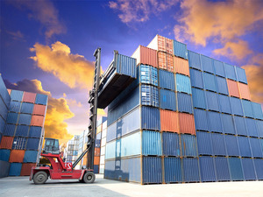
Containers – New degree of freedom
New concept of virtualization solution for PaaS and IaaS due to container’s increased density, isolation, elasticity and rapid provisioning
Containerization:
Use lightweight packages instead of full VMs
Move from a single large monolithic app to composition of microservices
Containerize different parts of an application
Move parts of apps into different types of cloud infrastructure
Simplify migration of applications between private, public and hybrid clouds

Slide 5
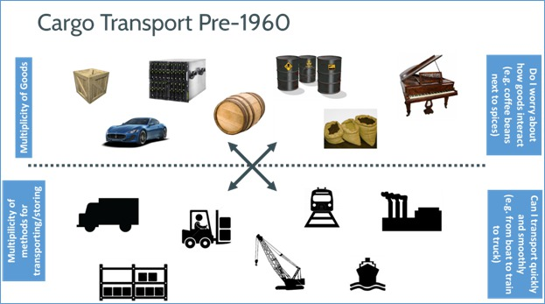
History of cargo transport

Slide 6
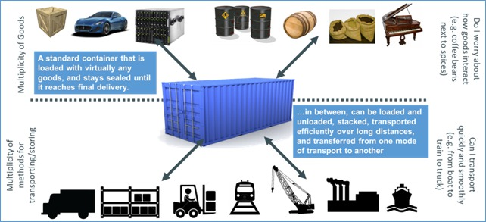
Solution to Shipping Challenge

Slide 7
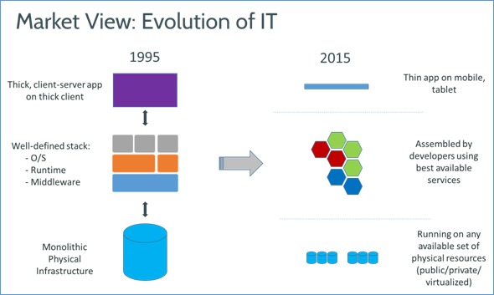
Analogy with virtualization
Historical way: $M mainframes
Modern way: virtual machines
Problem: performance overhead
Notes:
VT-x represents Intel's technology for virtualization on the x86 platform
The CPU flag for VT-x capability is "vmx"; in Linux, this can be
In computing, x86 virtualization refers to hardware virtualization for the x86 architecture. It allows multiple operating systems to simultaneously share x86 processor resources in a safe and efficient manner.
checked via /proc/cpuinfo, or in Mac OS X via sysctl machdep.cpu.features

Slide 8
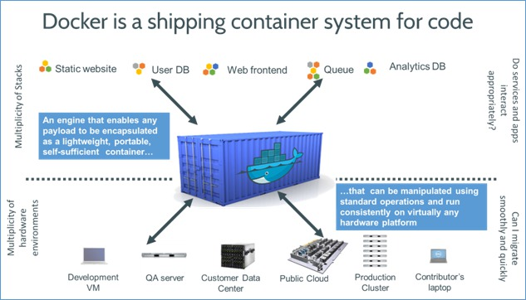
The Solution to Software Shipping
A Standard Container System

